Slide 1
Front End Engineering-I Project
Team Details:
Purab (2210990692)
Pushpinder (2210990693)
Puneet (2210990691)
Rachit (2210990694)
Faculty Coordinator: Dr . Mandeep Kaur
:
Chitkara University Institute of Engineering and Technology,
Chitkara University, Punjab

Slide 2
Table of Contents
Introduction
Problem Statement
Technical Details
Key Features
Project Highlights
Conclusion
References/Links used

Slide 3
Introduction
A survey form is a tool used to gather data and information from a group of people in a systematic and organized way. It typically consists of a series of questions designed to elicit specific information from respondents, such as demographic data, opinions, attitudes, behaviors, and preferences.
Surveys are commonly used in various fields, including marketing, research, education, social sciences, and healthcare. They can be administered in different formats, such as online surveys, paper-based surveys, telephone interviews, or face-to-face interviews.
A well-designed survey form can provide valuable insights into a particular topic or issue, helping to inform decision-making and identify areas for improvement. However, creating an effective survey form requires careful planning, including determining the research objectives, selecting the appropriate sample size and population, and crafting clear and concise questions.
Overall, survey forms are a powerful tool for gathering data and insights, providing a valuable source of information for businesses, researchers, and organizations seeking to understand their target audience and improve their operations

Slide 4
Problem Statement
The aim of a survey form is to gather information and insights from a specific group of people in a systematic and structured way. Surveys can be used to achieve a range of objectives, depending on the goals of the organization or individual conducting the survey.
Some common aims of survey forms include:
Understanding customer needs and preferences: Surveys can be used to gather information about customer demographics, behaviors, opinions, and attitudes, which can be used to improve products, services, and customer experiences.
Conducting market research: Surveys can help businesses and organizations to understand the competitive landscape, identify potential opportunities and threats, and gather insights into industry trends.
Measuring employee satisfaction: Surveys can be used to gauge employee satisfaction and engagement levels, identify areas for improvement, and inform HR and management decisions.
Conducting academic research: Surveys are commonly used in academic research to gather data on a specific topic or issue, such as social attitudes, behaviors, or health outcomes.
Collecting feedback and opinions: Surveys can be used to gather feedback from a wide range of stakeholders, including customers, employees, students, or community members, on various topics, such as product design, marketing campaigns, or social issues.

Slide 5
Technical Details
1. HTML Structure: Creating the basic HTML structure for our survey form, including the <form> element to wrap our survey questions, and use appropriate form-related tags such as <input>, <label>, <textarea>, etc.
for different types of questions.
2. CSS Styling: Used CSS to style the form elements, including setting the background color, font styles, margins, padding, etc. Also added custom CSS classes to style specific elements or groups of elements.
3. JavaScript Validation: Used JavaScript to validate the form input to ensure that required fields are filled out, and that the input matches the required format for each type of question. For example, we can use Regular Expressions (Regex) to validate email addresses and other specific input types

Slide 6
Key Features
Some key features of our survey form include:
Clear and concise questions
Properly structured and organized
Targeted audience
Validity and reliability
Adequate sample size
Informed consent
Multiple question types
Data analysis

Slide 7
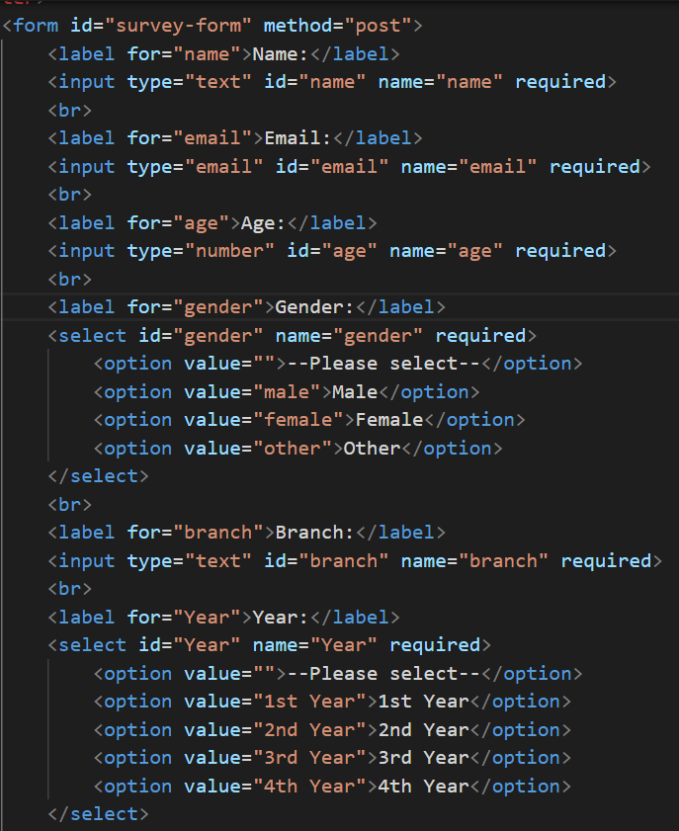
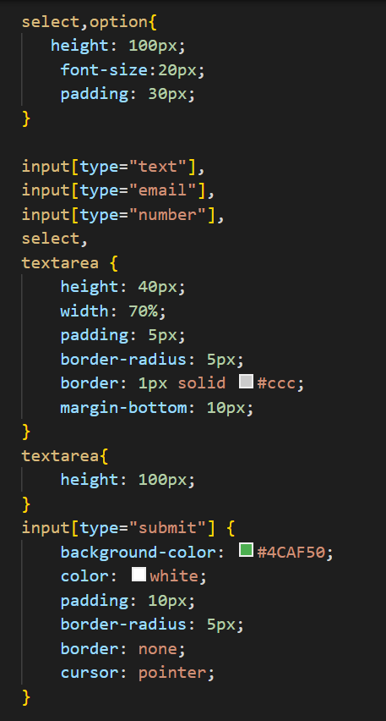
Project Highlights

Slide 8
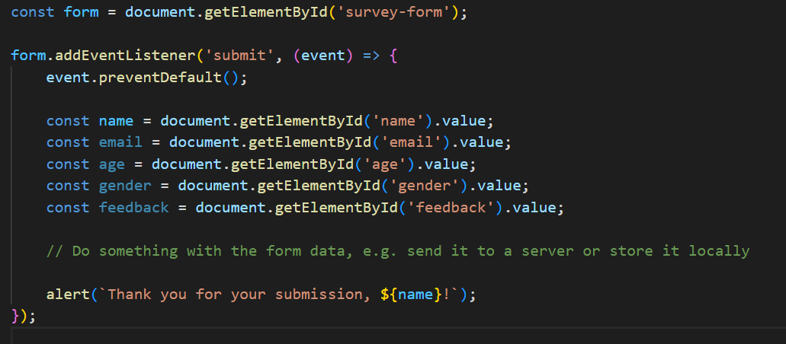
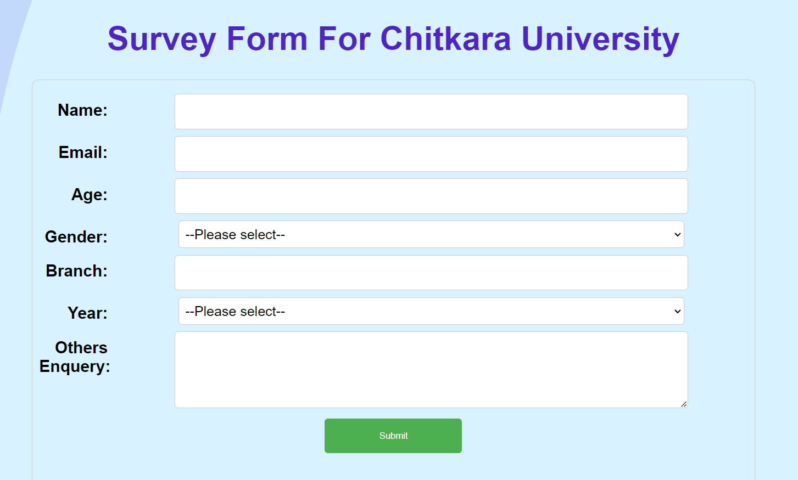
Project Highlights Continued

Slide 9
Conclusion
The conclusion of a survey form typically summarizes the findings and insights gained from the survey.
It may include a summary of the survey questions, response rates, and key findings, as well as any trends or patterns observed. The conclusion may also include recommendations or actions based on the survey
results.
In general, a good conclusion to a survey form should be concise and focused, highlighting the most important findings and takeaways. It should also be objective and based on the data collected, rather than personal opinions
or biases. Finally, the conclusion should be written in a clear and accessible manner, so that readers can easily understand and use the information presented.

Slide 10
References/Links used
https://www.w3schools.com/
https://www.google.com/chrome/

Slide 11


